Slide 1


Structure of Java

Slide 2
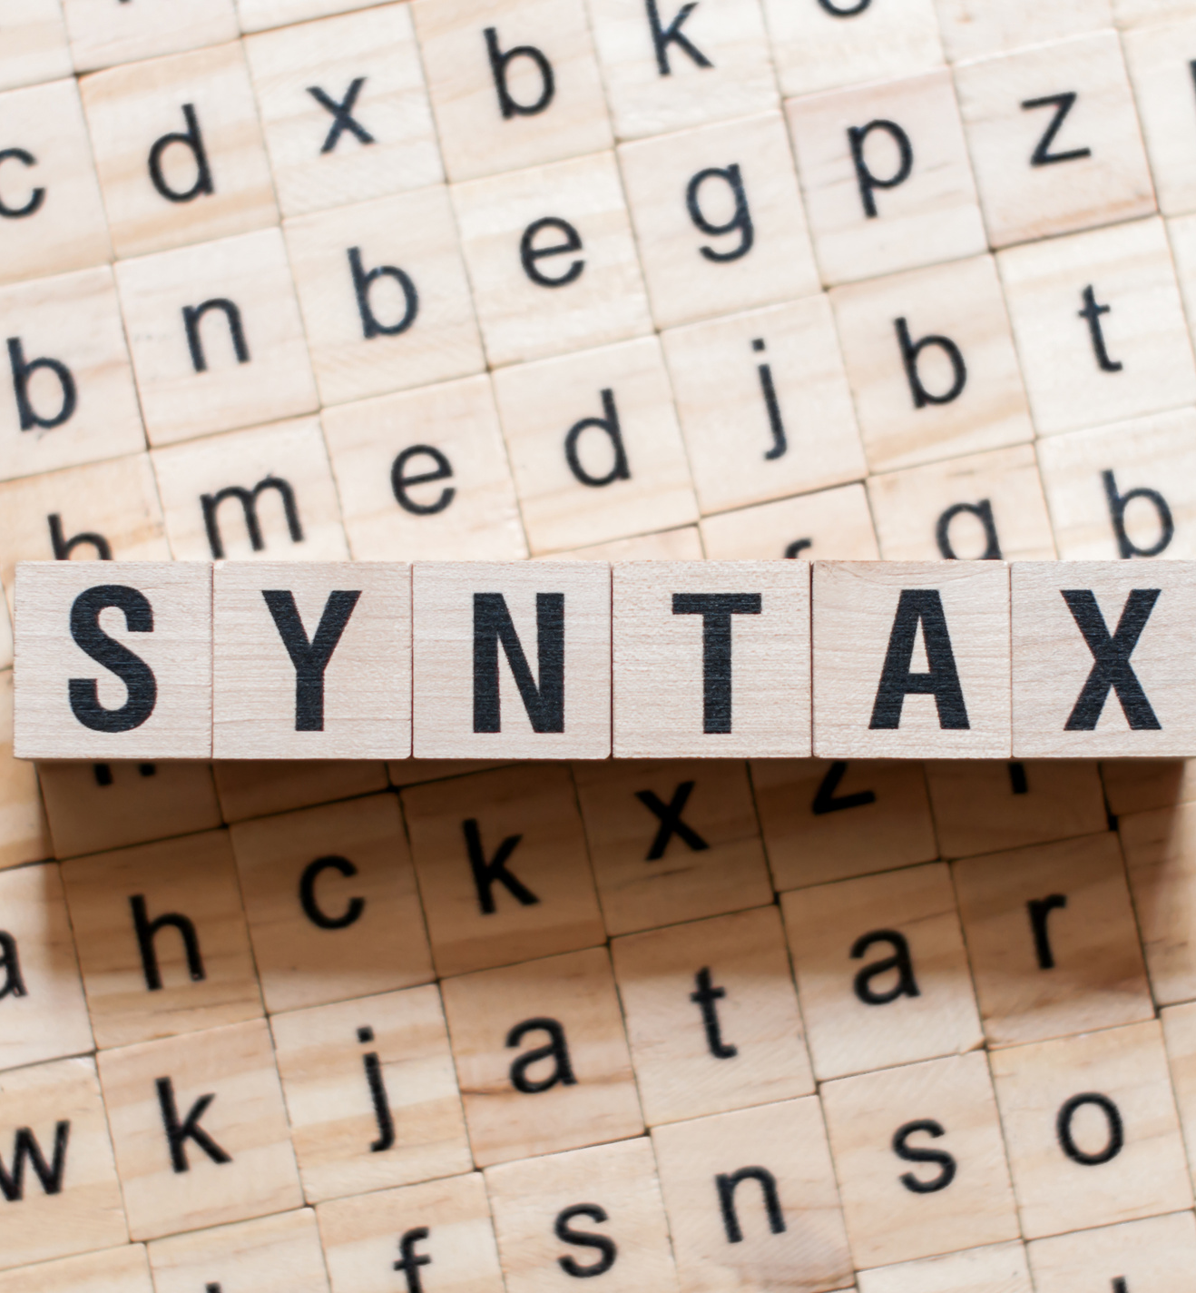




package packagename;
import packagename;
class classname{
variables;
methods/constructors;
main method(){
// executing code .
}
}

Slide 3

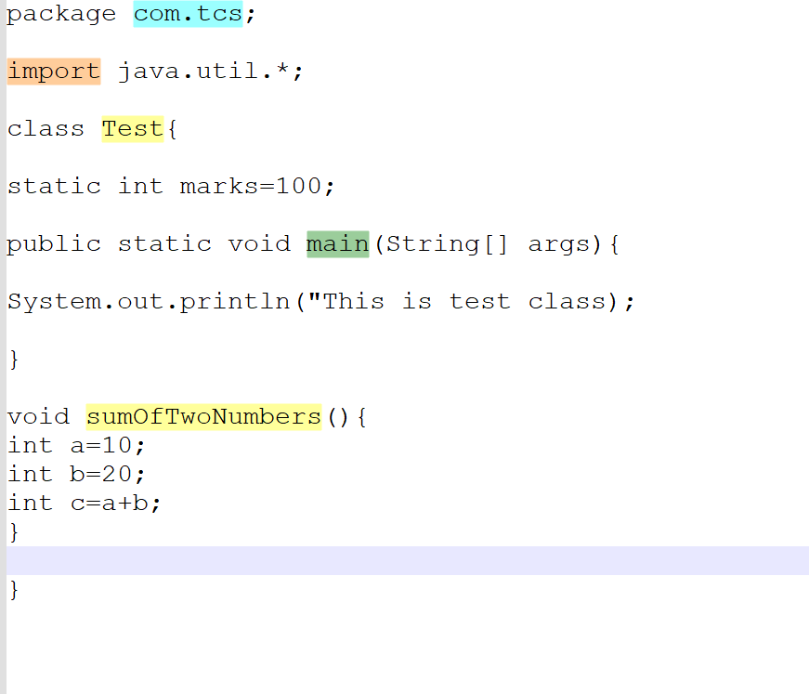

Slide 4


Slide 5
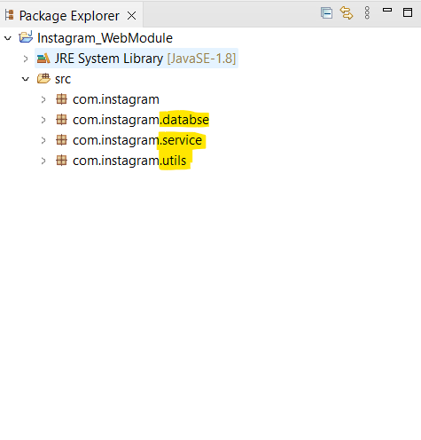
package statement
In real time we create packages for better code segregation.
package statement is completely optional(Mandatory for real time projects).
If we are writing a package it should be the first line.
Maximum one package statement can write.

Slide 6
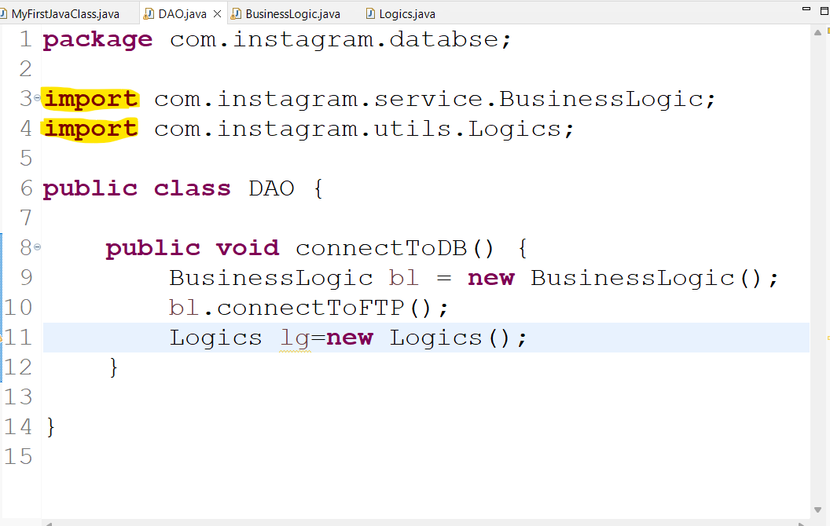
Import statement
To import existing and user defined packages.
Importing is also completely optional.
If we are writing an import statement after package and before class declaration.
We can write any number of imports.

Slide 7



Java Class ??

Slide 8

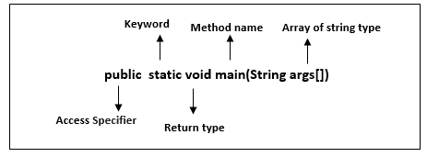
Main method in Java

Slide 9

Can write any number of statements.
But each statement should be terminated with ;(semicolon) j
java is case sensitive.
If no main method, code compiles but run time error occurs.
we can overload main method(Will be discussed in OOPS).

Slide 10


Code Comments

Slide 11
Single line comment - //
Multi line Comment
public void connectToDB() {
/*
* BusinessLogic bl = new BusinessLogic(); bl.connectToFTP(); Logics lg=new
* Logics();
*/
}

Slide 12


